Slide 1
UNIT 10:
Monitoring and Compliance

Slide 2
Monitoring & compliance
Activity 10.1: Class prior experience and local examples of compliance and monitoring activities.
What does adaptive management involve?

Slide 3
Final plan elements
The EAFM plan will not be complete without:
Monitoring
Compliance
Review process
These will need to be made part of your written EAFM plan

Slide 4
Monitoring
Monitoring will inform the success of the EAFM plan. This should be written up as a separate section in the plan.
Should include:
performance measures and reference levels for each of the operational objectives
data to be collected and the collection methods (biophysical, social and economic)
a documented plan for conducting the data collection (when, where, who, how)
how the data will be analysed (who, when)

Slide 5
Monitoring
Principles of good monitoring design:
Spread sampling throughout area of interest
Use replication to account for natural variability – the more the better
Minimise sources of variation
  Eg. fish numbers influenced by season, tide, time of day, depth, reef zone, visibility, etc.
Identify who will conduct monitoring and when
Develop robust data storage and analysis procedures
Seek expert advice on your design

Slide 6
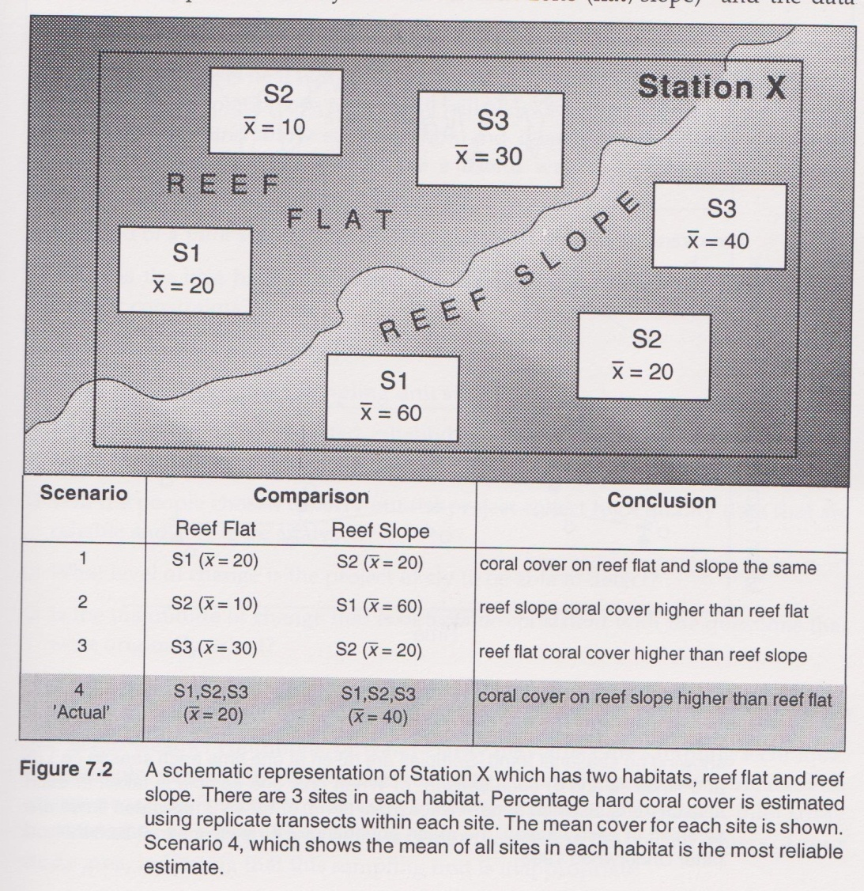
Replication

Slide 7
More on indicators
The most important characteristics in choosing indicators are that they must be:
representative of the system of interest;
sensitive to temporal and spatial rates of change;
unbiased;
feasible with respect to data collection; and
easy to interpret by the various user groups that will use them

Slide 8
Monitoring plan
Activity 10.2: Design a fisheries data collection program appropriate for your case study. Use the monitoring program guidelines provided in the EAFM plan template and refer to the operational objectives and the indicators identified during Unit 9. Modify these as needed. Include objectives of the monitoring plan.

Slide 9
Compliance
Stakeholders complying with an EAFM plan is another key to its success
Development of EAFM plan WITH stakeholders is the best way to ensure compliance
Key actions to encourage compliance:
  Education
  Routine surveillance
  Target specific behaviours
  Punishment

Slide 10
Compliance
Considerations for good compliance:
Identify who conducts the surveillance (provide power)
Identify what education programs to use
Take a risk-based approach to enforcement (limited resources)
Adopt a ‘crime scene investigation’ approach
Reward good behaviour
Coordinate compliance efforts
Provide adequate training
Ensure adequate funding for compliance activities
Maintaining records of compliance activities
Activity 10.3: Use the EAFM plan template to develop a compliance program for your case study EAFM plan

Slide 11
Review process
The final part of an EAFM plan must document a review process
Assesses how well the plans objectives are being met
Determines appropriate changes to the plan as necessary (adaptive management)
Identifies how frequently the plan will be reviewed
The review brings together stakeholders to assess:
monitoring data (performance measures)
compliance data
emerging issues
new background information

Slide 12
Review plan
Activity 10.4: Update EAFM plan with a timeframe and process for review of management effectiveness. If needed refer back to Figure 9.1 for how you might develop your plan review process.
15 minute personal review: unit review, students to review main concepts of unit in the course notes, contribute any new words (new to them) to their own personal glossary in the back of their notebook (local language equivalent terms should also be recorded where possible)

